Slide 1


Travel Tide Rewards Optimization:
Enhancing Customer Loyalty Through Data-Driven Segmentation
Mastery Project Presentation
Presented by Samiha Dider

Slide 2


Contents:
Introduction
Goal of the Project
Customer segmentation
Perks by Customer Segmentation
Demographic Analysis
Analysis of Travel pattern and discounts
Conversion and booking trends
Recommendation

Slide 3

Introduction
Introducing TravelTide: A Rising Star in Travel Tech
🔹 Founded in April 2021
🔹 Industry-Leading Inventory
🔹 Powered by Smart Technology

Slide 4

Goal Of the Project
Segmenting users based on booking behavior and demographics
Assigning personalized perks to optimize engagement and satisfaction
Delivering insights via interactive dashboards for informed decision-making

Slide 5

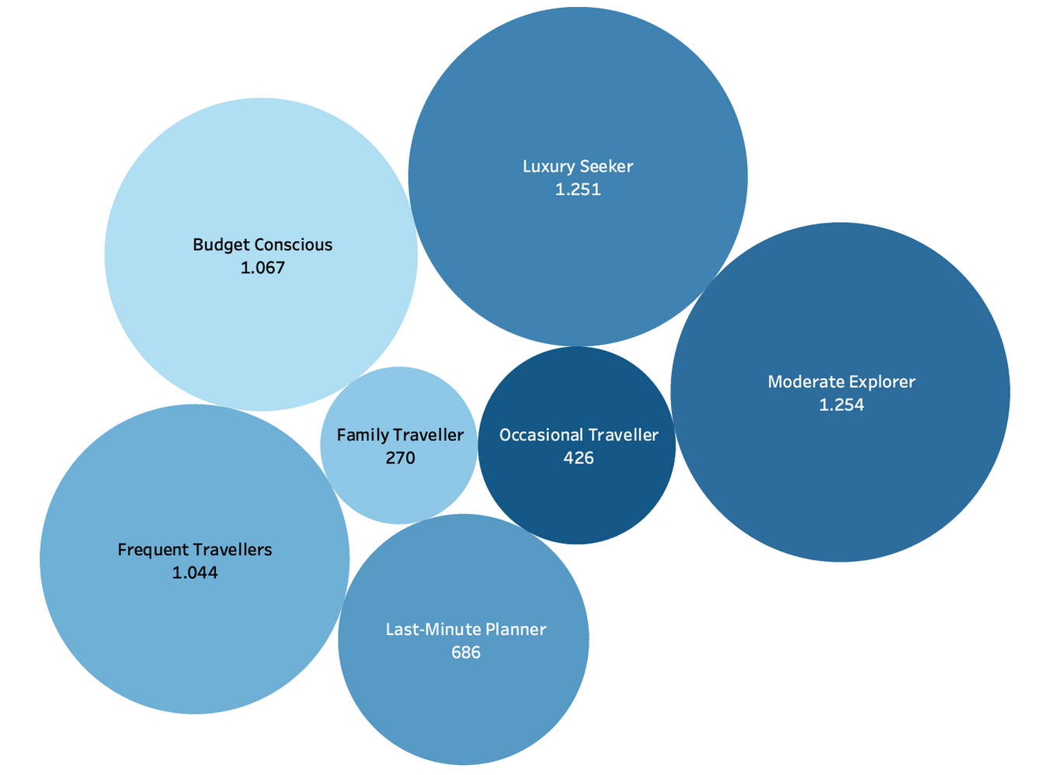
Customer Segmentation
Key Metrics for Segmentation:
Frequent Travellers: Regular bookers with 4+ trips and low cancellations
Family Travellers: Booked hotels with multiple rooms and longer stays
Luxury Seekers : High spenders on flights or hotel
Budget Conscious: Heavily used travel discounts
Last-Minute Planners: Booked trips within 7 days of departure
Moderate Explorers: Moderate activity with low cancellations
Occasional Travellers: Less engaged, minimal activity

Slide 6


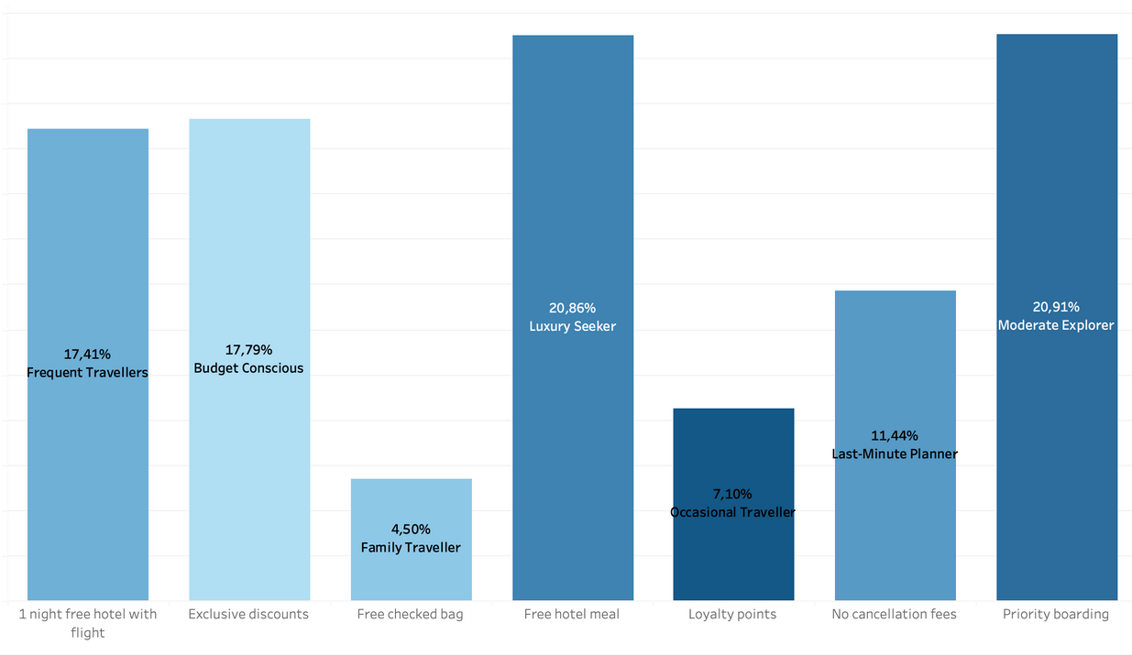
Perks by Customer Segmentation
Frequent Travellers → 1 Night Free Hotel with Flight
Family Travellers → Free Checked Bag
Luxury Seekers → Free Hotel Meal
Budget Conscious → Exclusive Discounts
Last-Minute Planners → No Cancellation Fees
Moderate Explorers → Priority Boarding
Occasional Travellers → Loyalty Points

Slide 7
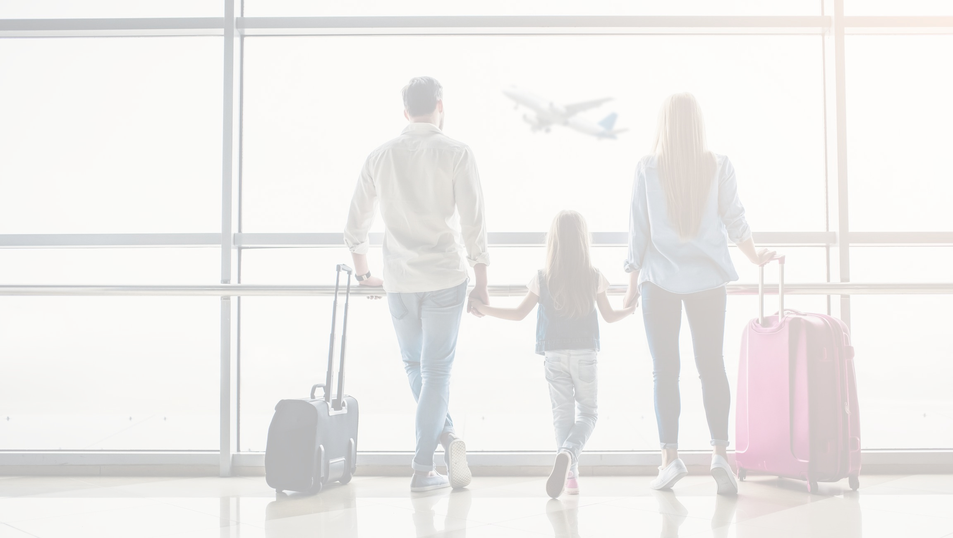
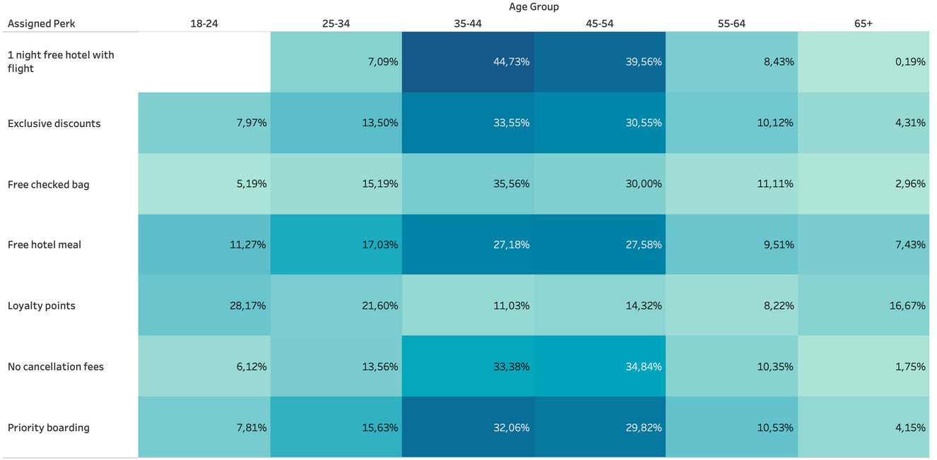
Demographic Analysis
18–24: Mostly receive Loyalty Points
25–34: Popular perks include Exclusive Discounts and Free Checked Bag
35–44: Frequently receive Priority Boarding and Hotel Meals
45+: Higher share of No Cancellation Fees and Free Hotel Nights
Gender distribution: 88% Female, 12% Male

Slide 8

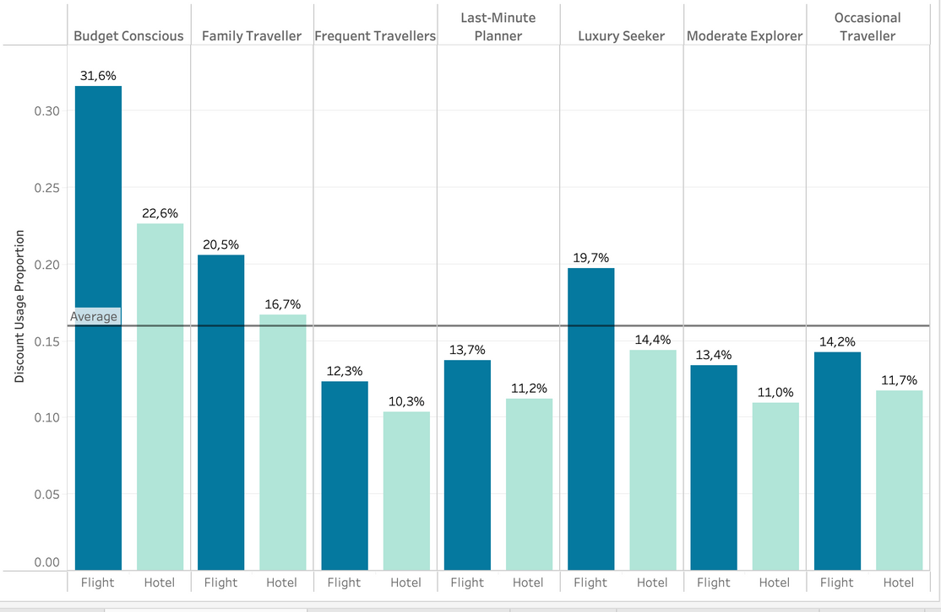
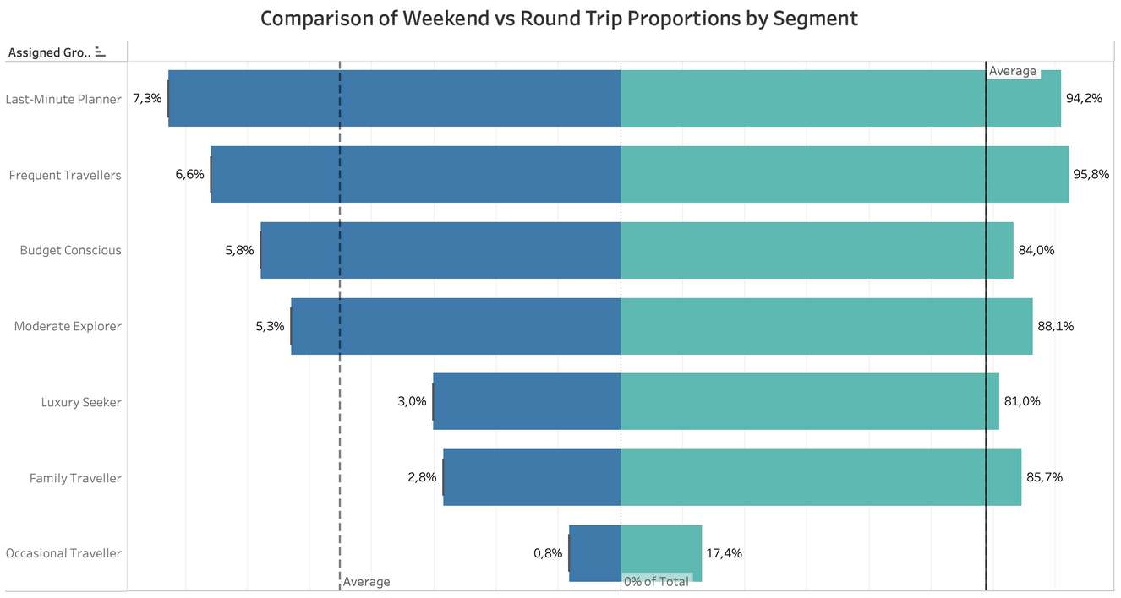
Analysis of Travel Patterns and Discount Behavior by Segment
Budget Conscious users lead in both hotel & flight discount usage
Luxury Seekers have lowest reliance on discounts
Family Travellers show strong preference for round trips
Last-Minute Planners show higher weekend trip tendencies
Frequent Travellers maintain a balanced pattern across both

Slide 9

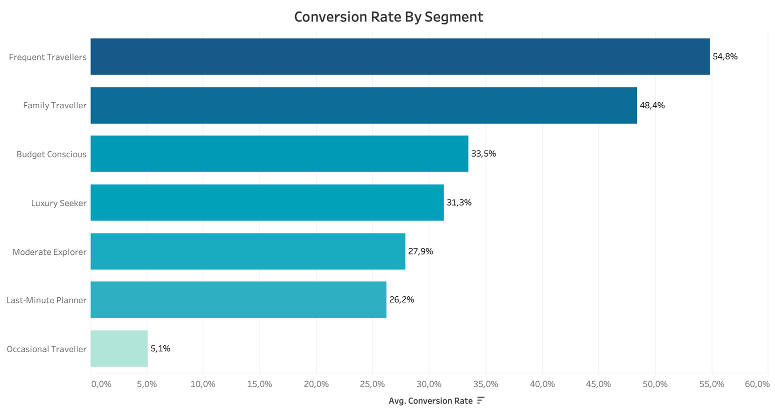
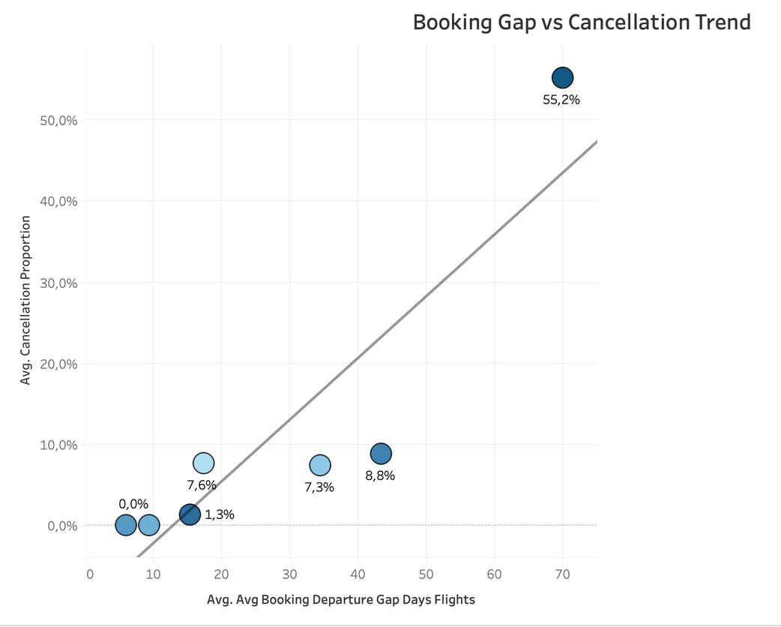
Conversion & Booking Trends by Segment
Frequent Travellers: Highest conversion and low cancellations
Last-Minute Planners: Short booking gap, slightly higher cancellations
Budget Conscious: Lower conversion but more stable commitment
Shorter gaps often link to increased cancellations

Slide 10
Recommendation
Personalized Perks: Deploy targeted perks by segment to increase loyalty and repeat bookings.
Monitor Engagement: Track segment-wise perk redemption to refine strategy.
Test & Iterate: A/B test perks across customer groups to optimize performance.
Demographic Alignment: Tailor marketing messaging to core demographics (e.g., 25–34, families).
Update Segments Quarterly: Recalculate segmentation periodically based on new behavior.

Slide 11
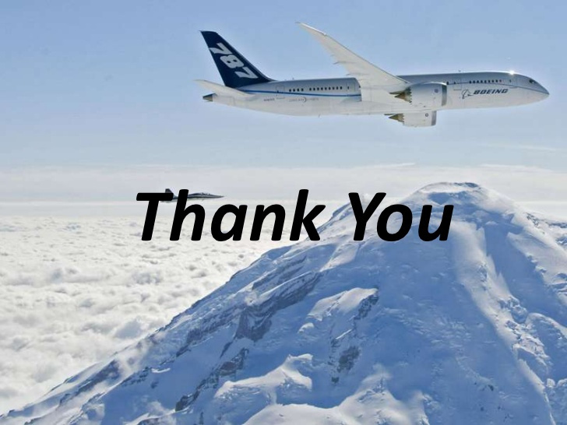

Github
Tableau

